Slide 1
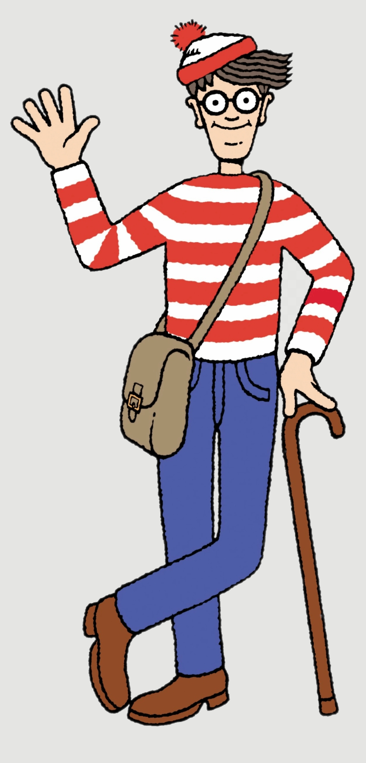
Every message in the Series will land the same way
Get ready to GROW and live life fully
There are no spectators in the Kingdom.
Gospel Reference
Practical Application
Personal Accountability
One action
One person
One follow-up
All message slides can be found at:
reboot.meetgodathome.com

Slide 2
🔑 Message Series –
“…By this everyone will know that you are my disciples, if you love one another.” John 13:35
OVERALL QUESTION: What does Love “LOOK” like from the outside?
How will someone see that you “love one another”?
👉 Get your Journal out or your phone to take notes!

Slide 3
Turning the Corner
We have weeded and turned over the soil
stopping destructive habits (speech, burdens, forgiveness, gossip, pride)
Now we start growing something beautiful!

Slide 4
Opening Prayer
Take us on a journey...
Open our hearts.
Stop us from being offended and start listening
Help us grow.
Help us get comfortable with being uncomfortable

Slide 5
Review
Every word you speak is either building the ‘Church’... Or burning it down. (Eph 4/James 3)
“Don’t do something for someone that God is expecting them to do! But always help with what they cannot do alone.” (Gal 6)
Serve One Another (skipped for now Acts 2-4)
Bear with one another… forgive one another… and above all these put on love.
(Col 3:12–14, Eph 4:31–32)
No more Triangles: Whether you were hurt or caused the hurt—Talk To Them, Not About Them. (Matt 5:23–24 & 18:15)

Slide 6
Love goes Low. The greater you are, the lower you must go. (John 13:1-17, Luke 22:24–27 )

Slide 7

last Time
📝 Mature love Goes Low
Who did you tell about the message?
Who encouraged you to do the challenge?
Did you TRY to do your unnoticed act of service?

Slide 8
Ice Breaker
Who knows about Barnabas?
Who remembers a time when one encouraging word changed everything?

Slide 9
Today's Big Idea
Love One Another #7
Many people are fighting invisible battles.
Sometimes they do not need advice.
Sometimes they need encouragement.
Encourage One Another
Love Builds Courage in Others
1 Thessalonians 5:11 / Hebrews 10:24–25

Slide 10
1 Thessalonians 5:11
¹¹ Therefore encourage one another and build one another up, just as you are doing.
Mature Love says:
“Keep Going!”
“You can do this!”
“God has got you!”

Slide 11
What Does Encourage Mean?
Give courage
Strengthen
Build up
Help someone to keep going

Slide 12
Encouragement Examples
I can't do this…
“For God gave us a spirit not of fear but of power and love and self-control.” (2 Timothy 1:7)
“My grace is sufficient for you, for my power is made perfect in weakness.” (2 Corinthians 12:9)
“I can do all things through him who strengthens me.” (Contentment and endurance, not achievement, Phil 4:13)

Slide 13
Hebrews 10:24–25
²⁴ And let us consider how to stir up one another to love and good works, ²⁵ not neglecting to meet together, as is the habit of some, but encouraging one another, and all the more as you see the Day drawing near.

Slide 14
“Stir up” or “Spur on”
Stirring someone into action - (paroxysmos)
So Hebrews isn't saying:
“Give them a nice compliment.” Or a free pass.
It's closer to:
“Figure out how to lovingly provoke one another into obedience.”
It varies from person to person and from time to time.

Slide 15
Spurring People to Grow
"God enables obedience and real fruit" verses.
⁵ I am the vine; you are the branches. Whoever abides in me and I in him, he it is that bears much fruit, for apart from me you can do nothing. (John 15:5)
"For it is God who works in you, both to will and to work for his good pleasure.“ (Philippians 2:13)

Slide 16
“love and good works”
⁸ For by grace you have been saved through faith. And this is not your own doing; it is the gift of God, ⁹ not a result of works, so that no one may boast. ¹⁰ For we are his workmanship, created in Christ Jesus for good works, which God prepared beforehand, that we should walk in them. (Eph 2:8-10)

Slide 17
Grace saves us. Not works.
Grace produces works.
Saving grace always produces good works.

Slide 18
Words Matter
A careless word can wound.
An encouraging word can heal.
Death and life are in the power of the tongue, and those who love it will eat its fruits. (Proverbs 18:21)
A Great Example…

Slide 19
Joseph’s Timeline
Acts 4 — Called Barnabas Son of Encouragement
Acts 9 — Barnabas believed in Paul.
Acts 11 — Barnabas searched for Paul.
Acts 13 — Barnabas served alongside Paul.
Acts 13 — Barnabas let Paul become the leader.
Acts 15 — Barnabas fought for Mark.
Later letters — Barnabas' investment bore fruit.
(Col 4:10, Philemon 23–24, 2 Tim 4:11)

Slide 20
Barnabas Changed History
Without Barnabas:
  Paul may have remained isolated in Tarsus
  Mark may have abandoned ministry.
  How much longer might it have taken for the Gospel to spread across Asia Minor?
  Who would have taken the Gospel to Cyprus?
  Who would have comforted Paul awaiting his execution?

Slide 21
  Nearly half the books of the New Testament may never have been written.
  Mark may never have written his Gospel, which many scholars believe was the earliest Gospel and an important source used by Matthew and Luke.
  One encourager changed history.

Slide 22
Jesus- The Best Encourager
Jesus' encouragement sounds like:
"I've got you.“
“I will be with you always”
"Take heart; it is I. Do not be afraid." (Matt 14:27)
"Come to me, all who labour and are heavy laden, and I will give you rest." (Matt 11:28)

Slide 23
Abide in me - John 15
"Whoever abides in me bears much fruit."
His encouragement isn't:
"You are strong."
It is:
"Stay with Me and you will bear fruit."

Slide 24
"I will not leave you as orphans." (John 14:18)
Then He sent the Holy Spirit. (‘Paraclete’.)
Helper
Comforter
Advocate
Encourager
One called alongside
Jesus literally gives us "the Encourager."

Slide 25
He encouraged us with hope
Hebrews repeatedly points believers to Christ.
Because Jesus lives...
  our suffering is temporary.
  our labour is not in vain.
  our future is secure.
Christian encouragement always looks forward.

Slide 26
The Gospel
Your sins are forgiven.
God has adopted you.
Christ has defeated death.
Nothing can separate you from His love.
He will never leave you.
He is preparing a place for you.
He is coming again.
That's not the power of ‘positive thinking’.
That's objective hope.

Slide 27
What Encouragement Looks Like
Thank you
That was an awesome job!
I appreciate you
Keep going
I'm praying for you
You can do this
God can do this!!

Slide 28
Hidden Encouragers
Not everyone encourages from the stage.
Many quietly strengthen the church by:
🙏 Praying faithfully.
🤝 Serving behind the scenes.
🏡 Opening their homes.
🚗 Giving someone a lift.
🏥 Visiting the sick.

Slide 29
☕ Listening over a coffee.
💳 Giving generously.
📞 Making a phone call.
✉️ Sending a message of encouragement.
😊 Simply noticing someone who is struggling.
🚪 The person who unlocks the church every week.
☕ The person who makes the tea and coffee.

Slide 30
🎵 The musicians who practise during the week.
🧹 The person who quietly cleans the building or mows the lawn.
📚 The Sunday School teachers who prepare every week and faithfully show up.
Some of the people who encourage everyone else are the very ones who most need encouragement themselves.

Slide 31
Two-sided Coin
Heads Tails
My Nature / The World What Jesus Wants
Weaken Strengthen
Criticise Restore
Compare Appreciate
Compete Build Up
Pull down Encourage
Only one side looks like Jesus

Slide 32
Second Coin
Two-sided Coin
Heads Tails
Encouragement says: Spurring on says:
1 Thes 5;11 Heb 10:24-25
“Keep Going!” "Let's go! Get on with it"
“You can do this” “What’s stopping you?”
Both Are Needed At the Right Time

Slide 33
Avoid the Two Ditches
Left Side - ❌ Flattery
Praise that isn't true.
Saying what people want to hear.
Avoiding difficult conversations.

Slide 34
Right Side - ❌ Constant Criticism
Always pointing out what is wrong.
"You'll never change."
"God can't use you."
"Someone else will do it."

Slide 35
Middle of the Road
✅ Biblical Encouragement
"Speak the truth in love...“Eph 4:15
Build courage.
Call people to Trust Jesus and the HS.
Help them obey Christ.
"I believe God can help you grow."
Let's take the next step together.

Slide 36
Diagnostic Questions
Do my words build people up?
Who needs encouragement this week?
Do people leave stronger after talking to me?

Slide 37
Take Note
📝 Mature love strengthens others.
📝 Love builds courage in others.

Slide 38
Call To Action
Encourage three people this week.
One at church.
One at home.
One outside church.

Slide 39
Loving Accountability
Who are you going to share this with that WAS NOT here today?
Who will ask if you did it?
Who will encourage you to do it?

Slide 40
Conclusion
A disciple of Jesus:
Speaks life
Helps wisely
Forgives, and where possible restores
Goes directly to the person
Goes low.
"Builds courage."

Slide 41
Final Word
Jesus put courage into us.
Now go and put courage into someone else.

Slide 42
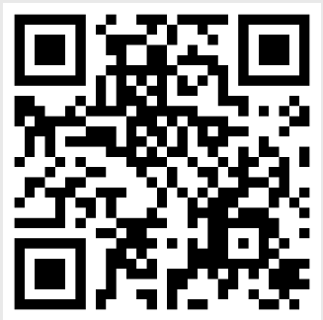
Closing Prayer
Lord, teach us to love each other like You loved us.
Help us build people up
reboot.meetgodathome.com

