Slide 1
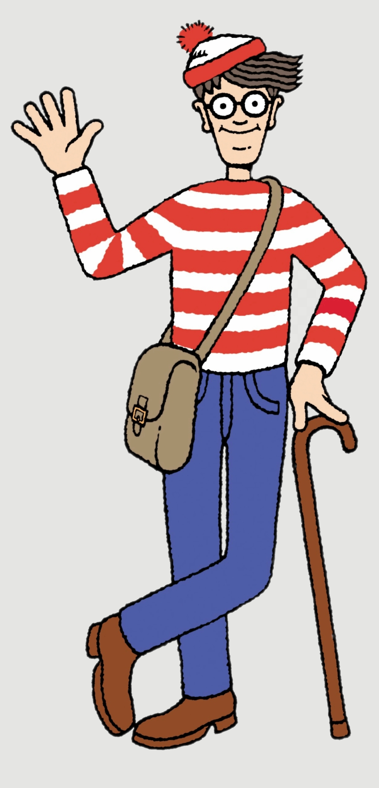
Every message in the Series will land the same way
Get ready to GROW and live life fully
There are no spectators in the Kingdom.
Gospel Reference
Practical Application
Personal Accountability
One action
One person
One follow-up
All message slides can be found at:
reboot.meetgodathome.com
Love One Another | Go Low John 13:1-20

Slide 2
🔑 Message Series –
“…By this everyone will know that you are my disciples, if you love one another.” John 13:35
OVERALL QUESTION: What does Love “LOOK” like from the outside?
How will someone see that you “love one another”?
👉 Get your Journal out or your phone to take notes!

Slide 3
Opening Prayer
Take us on a journey...
Open our hearts.
Stop us from being offended and start listening
Help us grow.
Help us get comfortable with being uncomfortable

Slide 4
Review
Every word you speak is either building the ‘Church’... Or burning it down. (Eph 4/James 3)
“Don’t do something for someone that God is expecting them to do! But always help with what they cannot do alone.” (Gal 6)
Serve One Another (skipped for now Acts 2-4)
Bear with one another… forgive one another… and above all these put on love.
(Col 3:12–14, Eph 4:31–32)
No more Triangles: Whether you were hurt or caused the hurt—Talk To Them, Not About Them. (Matt 5:23–24 & 18:15)

Slide 5
📝 Take Note – last Time
📝 Mature love moves toward people.
📝 Love goes direct.
Noah did, and I tried!
Did you try to do it?
Did you tell someone about the message that was not here to hear it?
Have you got an accountability partner yet?

Slide 6
Warning
📝 YouTube is NOT your friend
📝 Great teachers can still be wrong.
📝 Popular teachers are often wrong.
📝 I can be wrong.
📝 God's Word is never wrong.
Test everything. Hold fast to what is good.
(Acts 17:11; 1 John 4:1; 1 Thessalonians 5:21)

Slide 7


Slide 8
Colossians 1:16-17
¹⁶ For by him (Jesus) all things were created, in heaven and on earth, visible and invisible, whether thrones or dominions or rulers or authorities—all things were created through him and for him. ¹⁷ And he is before all things, and in him all things hold together.

Slide 9
He created everything
Psalms 147:4
"He determines the number of the stars; he gives to all of them their names." (ESV)
Matthew 10:30
He Knows You Completely
Even the hairs of your head
are all numbered.

Slide 10
Jesus is
The Creator.
The Sustainer.
The King.
The One who knows everything.
The One who knows YOU!
The One who still loves YOU!

Slide 11
Jesus knew:
Knowing exactly who He was...
He picks up a towel

Slide 12
Today - #6: Love Goes Low
John 13:1-17 (Same section as this whole series)
The King Who Washed Feet

Slide 13
13 Now before the Feast of the Passover, when Jesus knew that his hour had come to depart out of this world to the Father, having loved his own who were in the world, he loved them to the end. ² During supper, when the devil had already put it into the heart of Judas Iscariot, Simon's son, to betray him, ³ Jesus, knowing that the Father had given all things into his hands, and that he had come from God and was going back to God, ⁴ rose from supper. He laid aside his outer garments, and taking a towel, tied it around his waist.

Slide 14
⁵ Then he poured water into a basin and began to wash the disciples' feet and to wipe them with the towel that was wrapped around him. ⁶ He came to Simon Peter, who said to him, “Lord, do you wash my feet?” ⁷ Jesus answered him, “What I am doing you do not understand now, but afterward you will understand.” ⁸ Peter said to him, “You shall never wash my feet.” Jesus answered him, “If I do not wash you, you have no share with me.” ⁹ Simon Peter said to him, “Lord, not my feet only but also my hands and my head!” ¹⁰ Jesus said to him, “The one who has bathed does not need to wash, except for his feet, but is completely clean. And you are clean…

Slide 15
¹² When he had washed their feet and put on his outer garments and resumed his place, he said to them, “Do you understand what I have done to you? ¹³ You call me Teacher and Lord, and you are right, for so I am. ¹⁴ If I then, your Lord and Teacher, have washed your feet, you also ought to wash one another's feet. ¹⁵ For I have given you an example, that you also should do just as I have done to you. ¹⁶ Truly, truly, I say to you, a servant is not greater than his master, nor is a messenger greater than the one who sent him. ¹⁷ If you know these things, blessed are you if you do them.

Slide 16
Today's Big Idea
If you get this you get the whole series!
Mature love serves from below.
The greater you are,
the lower you go.

Slide 17
The King Goes Low
The issue is not foot washing.
The issue is:
Why is HE washing feet?

Slide 18
Dirty Feet
No cars
No concrete
No shoes
Animals everywhere
Hot dusty roads
This was disgusting work.

Slide 19
Servant's Work
Foot washing belonged to:
the lowest servant
Not the highest person.

Slide 20
Earlier that same night (Luke 22:24–27)
"A dispute also arose among them, as to which of them was to be regarded as the greatest."
Then Jesus says:
"Rather, let the greatest among you become as the youngest, and the leader as one who serves."
and the knockout line:
"For who is the greater, one who reclines at table or one who serves? Is it not the one who reclines at table? But I am among you as the one who serves.“

Slide 21
Nobody Moved
The disciples all saw the feet.
Nobody moved…….
Everybody waited.

Slide 22
Then Jesus Moved
Then he picks up the prepared towel and bowl…
The highest person in the room
did the lowest job.
He Modelled what he wanted them to be like!

Slide 23
The Gospel
This is the whole Gospel.
Though equal with God... He humbled Himself as a servant. (Philippians 2)
Jesus always moved downward.
Become one of us, a frail human.
Died on the Cross for you and me.
True Servanthood.

Slide 24
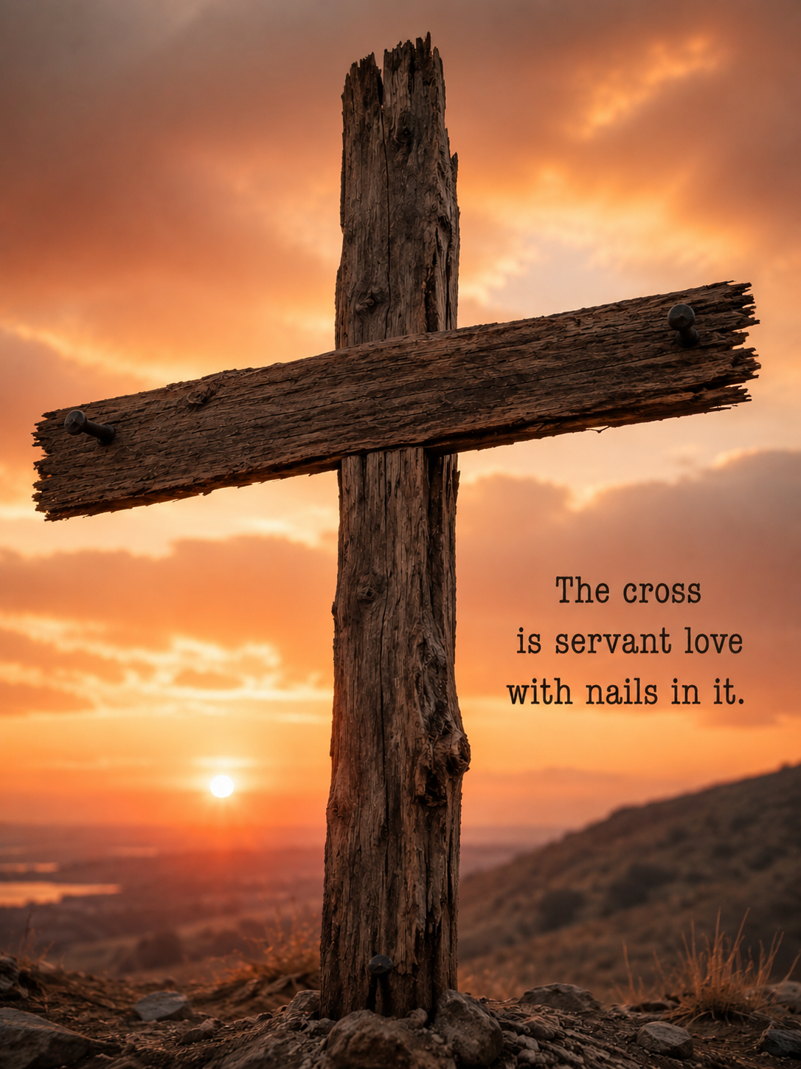

Slide 25
Peter Objected
"Never shall you wash my feet."
Peter understood:
This felt wrong.

Slide 26
Why Peter Struggled
Because pride understands:
Up
power
position
importance
But not humility.

Slide 27
Two-sided Coin
Heads Tails
My Nature What Jesus Wants
Serve Me Serve Others
Only one side looks like Jesus

Slide 28
The World's Way
Climb higher.
Be recognised.
Be important.
Get served.

Slide 29
Jesus' Way
Go lower.
Serve quietly.
Lift others.
Take the towel.

Slide 30
Some Examples of Ordinary Jobs
Cooking a Meal
Cleaning (not for payment)
Driving someone to the hospital/airport
Visiting (Hospital/nursing home/house)
Cutting hair/nails
Just Listening to, and Praying with them
Volunteering at the Seafarers’ Mission or Sunday School

Slide 31
Helping OTHERS,
Allowing OTHERS,
Equipping OTHERS,
Putting others up first, above yourself

Slide 32
The Hidden Things
Nobody sees:
Prayer
Sacrifice
Serving
Giving
Encouraging
But God sees.

Slide 33
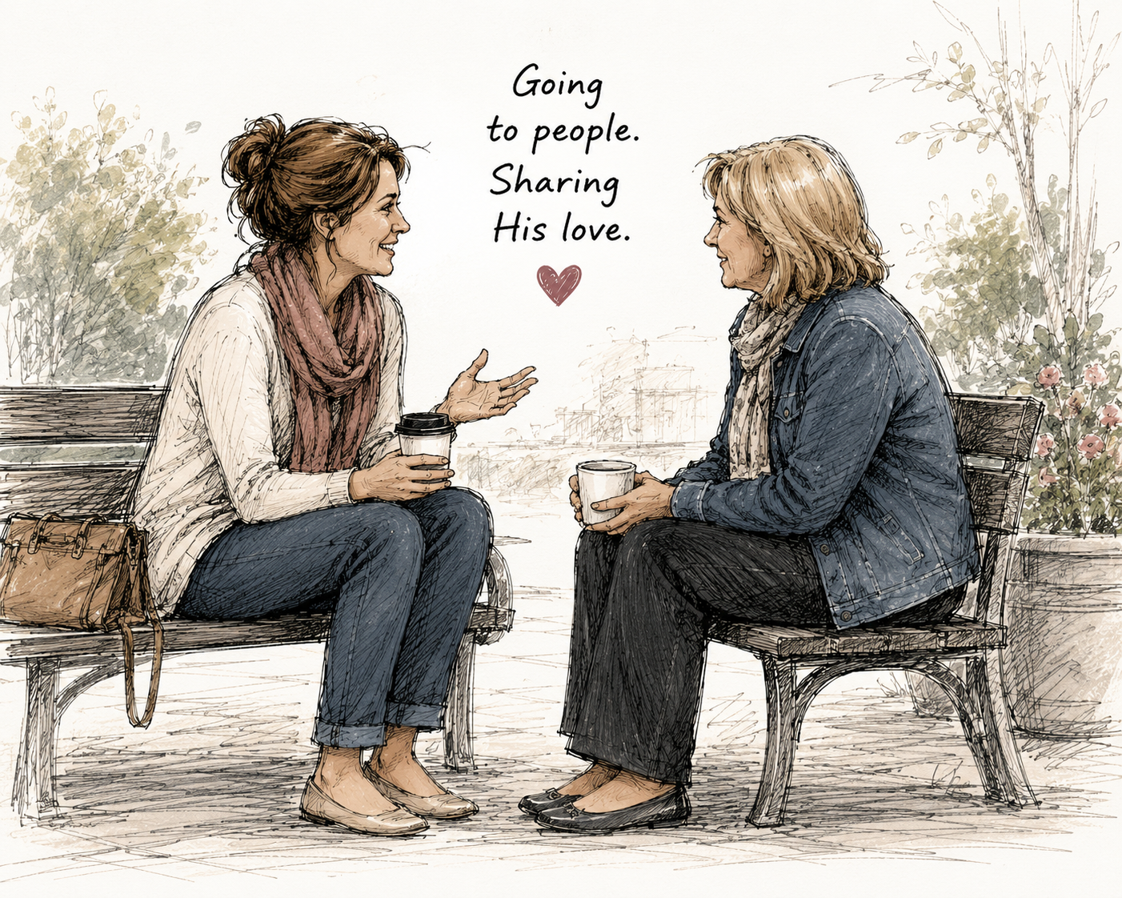
Once Going Low is in Your DNA
You become a great witness for Jesus
People notice and ask you why you:
  Return someone else’s trolley to the bay
  Help the elderly with their shopping to the car
  Ask the checkout operator how they're really doing!
  Thank the waitress/er and clean up your own mess.
  If you can, Offer to pay for someone’s coffee/food when their bank card fails ahead of you.

Slide 34
Avoid the Two Ditches
Serve to be noticed.
Never serve at all.
Mature love serves quietly in the middle of the road.

Slide 35
Diagnostic Questions
Do I expect others to serve me?
Do I notice what needs doing?
Am I willing to do the low jobs?
⭐ ….. If I do see someone who is quietly serving low… Do I quietly encourage them and appreciate them?

Slide 36
Take Note
📝 The greater you are,
the lower you go.
📝 Love goes low.

Slide 37
Call To Action
Do one unnoticed act of service this week.
Tell nobody.
(Except your accountability partner.)

Slide 38
Loving Accountability
Who are you going to share this with that WAS NOT here today?
Who will ask if you did the challenge?
Who will encourage you to do it?

Slide 39
Every week we've asked the same question:
What does love look like from the outside?
Today we have the answer.
Love picks up the towel.

Slide 40
Conclusion
Mature love (a disciple of Jesus):
🗣 Speaks life.
🤝 Helps wisely.
❤️ Forgives freely.
➡️ Goes direct.
🪣 Takes the towel.

Slide 41
Final Line
Love goes low.

Slide 42
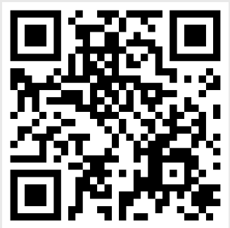
Closing Prayer
Lord, teach us to love each other like You loved us.
Help us to be forever grateful to you because you gave up everything and came down to us.
Help us shed pride
Help us to be humble and help others quietly.
reboot.meetgodathome.com

