Slide 1
#4 Serve and Share
Mature love serves gladly and shares freely
Acts 2:42–47 / Acts 4:32–35
“By this everyone will know...” John 13:35
14/08/2026
Love One Another | Serve and Share — Love Uses What It Has | Acts 2 / Acts 4
1

Slide 2
Every message lands the same way
Get ready to GROW and live life fully.
There are no spectators in the Kingdom.
Gospel Reference
Practical Application
Personal Accountability
One action • One person • One follow-up
All message slides: reboot.meetgodathome.com
14/08/2026
Love One Another | Serve and Share — Love Uses What It Has | Acts 2 / Acts 4
2

Slide 3
Message Series
“…By this everyone will know that you are my disciples,
if you love one another.” John 13:35
OVERALL QUESTION:
What does love LOOK like from the outside?
How will someone see that you love one another?
👉 Get your journal out or your phone to take notes!
14/08/2026
Love One Another | Serve and Share — Love Uses What It Has | Acts 2 / Acts 4
3

Slide 4
Where This Fits
So far:
Speech — love builds up with words.
Burdens and Loads — love helps wisely.
Bear with and Forgive – (Restore where possible)
Today:
Serve and Share — love becomes visible through hands, homes, time, gifts and resources.
14/08/2026
Love One Another | Serve and Share — Love Uses What It Has | Acts 2 / Acts 4
4

Slide 5
Opening Prayer
Lord Jesus,
open our eyes to the needs around us.
Free us from spectator Christianity.
Teach us to serve gladly,
share freely,
and love each other in ways people can actually see.
14/08/2026
Love One Another | Serve and Share — Love Uses What It Has | Acts 2 / Acts 4
5

Slide 6
Review
Speaks life — not burning the church down. (Eph 4 / James 3)
Helps wisely — burdens and loads. (Gal 6)
Bear with and Forgive – (Restore where possible) (Col 3, Eph 4)
Now we ask:
What happens when love sees a practical need?
14/08/2026
Love One Another | Serve and Share — Love Uses What It Has | Acts 2 / Acts 4
6

Slide 7
Last Time
📝 Mature love Bears with one another.
Who did you encourage?
Who did you extend your patience with this week?
Who checked in on you? (Your accountability buddy)
What did you learn?
Who did you share last week's message with that was not there to hear it?
14/08/2026
Love One Another | Serve and Share — Love Uses What It Has | Acts 2 / Acts 4
7

Slide 8
Ice Breaker
Have you ever been in a group where everyone saw the need...
but everyone waited for someone else to do something?
What happened?
14/08/2026
Love One Another | Serve and Share — Love Uses What It Has | Acts 2 / Acts 4
8

Slide 9
Today’s Big Idea
Love One Another #4
Love becomes visible when disciples
serve one another
and share what they have.
Mature love serves gladly and shares freely.
14/08/2026
Love One Another | Serve and Share — Love Uses What It Has | Acts 2 / Acts 4
9

Slide 10
Acts Gives Us a Picture
Acts does not show us a perfect church.
It shows us a Spirit-filled church
learning to live as a family.
Their love was not merely spoken.
It was seen.
14/08/2026
Love One Another | Serve and Share — Love Uses What It Has | Acts 2 / Acts 4
10

Slide 11
Acts 2:42–47
They devoted themselves to:
• the apostles’ teaching
• fellowship
• the breaking of bread
• prayer
They were together.
They shared.
They praised God.
Others noticed.
14/08/2026
Love One Another | Serve and Share — Love Uses What It Has | Acts 2 / Acts 4
11

Slide 12
Notice the Pattern
Word.
Prayer.
Fellowship.
Meals.
Generosity.
Joy.
Witness.
Love was not an event.
Love was their shared life.
14/08/2026
Love One Another | Serve and Share — Love Uses What It Has | Acts 2 / Acts 4
12

Slide 13
Not Just “Attend Church”
The first believers did not merely attend the same meeting.
They shared a life.
They noticed needs.
They opened their homes.
They used what they had for others.
That is visible love.
14/08/2026
Love One Another | Serve and Share — Love Uses What It Has | Acts 2 / Acts 4
13

Slide 14
Take Note
📝 Mature love serves gladly and shares freely.
Serving says:
“Your need matters to me.”
Sharing says:
“What God gave me is not only for me.”
14/08/2026
Love One Another | Serve and Share — Love Uses What It Has | Acts 2 / Acts 4
14

Slide 15
Acts 4:32–35
The believers were described as:
one heart and one soul.
They held things with open hands.
They cared for those in need.
The apostles kept proclaiming the resurrection.
14/08/2026
Love One Another | Serve and Share — Love Uses What It Has | Acts 2 / Acts 4
15

Slide 16
Open Hands
The issue is not whether everyone owned the same amount.
The issue is this:
Do I see my time, gifts, home, money and strength as tools for loving the body of Christ?
14/08/2026
Love One Another | Serve and Share — Love Uses What It Has | Acts 2 / Acts 4
16

Slide 17
This Was Not Forced
Biblical generosity is not manipulation.
It is not guilt.
It is not control.
It is Gospel-shaped freedom.
Freely we have received.
Freely we give.
14/08/2026
Love One Another | Serve and Share — Love Uses What It Has | Acts 2 / Acts 4
17

Slide 18
The Gospel
Sin turns us inward.
“Mine.”
“My comfort.”
“My time.”
“My rights.”
Jesus moves toward us.
He serves.
He gives.
He lays down His life.
14/08/2026
Love One Another | Serve and Share — Love Uses What It Has | Acts 2 / Acts 4
18

Slide 19
Jesus Served Us First
The Son of Man came not to be served,
but to serve,
and to give His life as a ransom for many.
Mark 10:45
14/08/2026
Love One Another | Serve and Share — Love Uses What It Has | Acts 2 / Acts 4
19

Slide 20
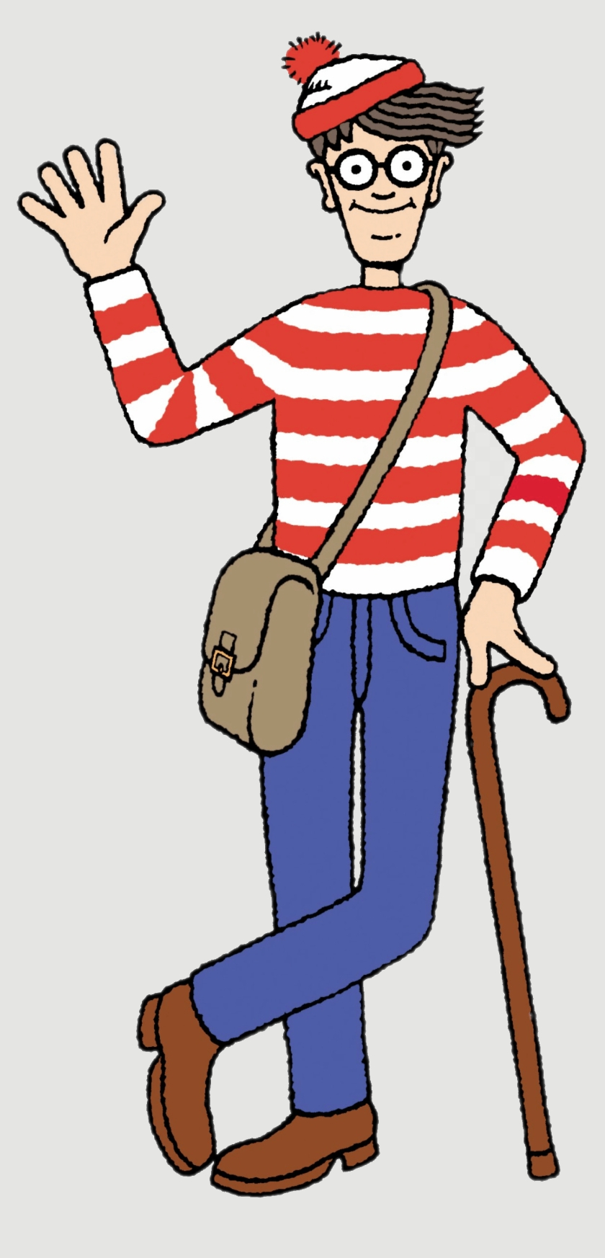
The Gospel
We were separated from God by sin.
God came down to meet us in Jesus.
Jesus died in our place.
God raised Him from the dead.
We are forgiven and made new
when we turn, trust Him, and follow Him as Lord.
14/08/2026
Love One Another | Serve and Share — Love Uses What It Has | Acts 2 / Acts 4
20

Slide 21
So Our Love Has a Source
We do not serve to earn God’s love.
We serve because we have received God’s love.
We do not share to look spiritual.
We share because Christ has shared His life with us.
14/08/2026
Love One Another | Serve and Share — Love Uses What It Has | Acts 2 / Acts 4
21

Slide 22
Serve
Serve means love takes practical action.
It asks:
What needs doing?
Who is being overlooked?
What burden can I lighten?
What small job would bless someone?
14/08/2026
Love One Another | Serve and Share — Love Uses What It Has | Acts 2 / Acts 4
22

Slide 23
Share
Share means love opens its hands.
It asks:
What has God placed in my hand?
Could my table make room?
Could my car help?
Could my time encourage?
Could my skills bless?
14/08/2026
Love One Another | Serve and Share — Love Uses What It Has | Acts 2 / Acts 4
23

Slide 24
1 Peter 4:10
Each one has received a gift.
Use it to serve one another.
God’s grace comes in many forms,
and He distributes it through ordinary people.
14/08/2026
Love One Another | Serve and Share — Love Uses What It Has | Acts 2 / Acts 4
24

Slide 25
Everyone Has Something
Some can teach.
Some can cook.
Some can listen.
Some can visit.
Some can repair.
Some can pray.
Some can encourage.
Some can notice what others miss.
14/08/2026
Love One Another | Serve and Share — Love Uses What It Has | Acts 2 / Acts 4
25

Slide 26
No Spectators
The church is not a theatre.
The church is a body.
In a theatre, a few perform while many watch.
In a body, every part has a purpose.
14/08/2026
Love One Another | Serve and Share — Love Uses What It Has | Acts 2 / Acts 4
26

Slide 27
Acts 6 Shows the Tension
As the church grew, some widows were being overlooked.
The answer was not:
“Someone should do something.”
The answer was organised, Spirit-filled serving
so people were cared for.
14/08/2026
Love One Another | Serve and Share — Love Uses What It Has | Acts 2 / Acts 4
27

Slide 28
Serve So No One Is Overlooked
Mature love notices quiet needs:
people sitting alone
new believers
tired parents
older saints
sick people
people without transport
people who do not know how to ask for help
14/08/2026
Love One Another | Serve and Share — Love Uses What It Has | Acts 2 / Acts 4
28

Slide 29
Avoid the Two Ditches
Left Side — ❌ Talk Without Action
“I care.”
“I’ll pray.”
“That’s sad.”
But no follow-through.
Visible love needs hands and feet.
14/08/2026
Love One Another | Serve and Share — Love Uses What It Has | Acts 2 / Acts 4
29

Slide 30
Avoid the Two Ditches
Right Side — ❌ Rescue and Burn Out
Doing everything.
Creating dependency.
Taking over.
Serving for approval.
Never saying no.
That is not wise love.
14/08/2026
Love One Another | Serve and Share — Love Uses What It Has | Acts 2 / Acts 4
30

Slide 31
Middle of the Road
✅ Biblical Serve and Share
Need seen.
Prayer offered.
Action taken.
Boundaries honoured.
Others invited in.
Jesus glorified.
14/08/2026
Love One Another | Serve and Share — Love Uses What It Has | Acts 2 / Acts 4
31

Slide 32
What It Sounds Like
“I can help with that.”
“Can I bring a meal?”
“Would a lift help?”
“Who else could we involve?”
“Let’s pray now.”
“I have this skill — can I use it?”
“I cannot do everything, but I can do this.”
14/08/2026
Love One Another | Serve and Share — Love Uses What It Has | Acts 2 / Acts 4
32

Slide 33
What It Looks Like
A phone call.
A visit.
A meal.
A lift.
A repair.
A seat at the table.
A prayer in the moment.
A quiet job done without needing applause.
14/08/2026
Love One Another | Serve and Share — Love Uses What It Has | Acts 2 / Acts 4
33

Slide 34
Small Churches Can Do This Well
We may not have big programs.
But we can notice quickly.
We can respond personally.
We can include people by name.
We can make love visible in ordinary life.
14/08/2026
Love One Another | Serve and Share — Love Uses What It Has | Acts 2 / Acts 4
34

Slide 35
Why This Matters for Witness
Outsiders may not understand our songs.
They may not understand our Bible words.
They may not understand our church culture.
But they can understand visible love.
14/08/2026
Love One Another | Serve and Share — Love Uses What It Has | Acts 2 / Acts 4
35

Slide 36
The Multiplication Principle
When ordinary disciples learn to serve and share, ministry is no longer trapped in one leader.
Love spreads through the whole body.
Needs are met faster.
New disciples see what obedience looks like.
14/08/2026
Love One Another | Serve and Share — Love Uses What It Has | Acts 2 / Acts 4
36

Slide 37
The Question
What has God already put in your hand?
A gift.
A table.
A vehicle.
A skill.
A spare hour.
A listening ear.
A word of encouragement.
Who needs it this week?
14/08/2026
Love One Another | Serve and Share — Love Uses What It Has | Acts 2 / Acts 4
37

Slide 38
Take Note
📝 Mature love serves gladly and shares freely.
📝 Love uses what it has.
📝 Visible love notices needs and takes one faithful step.
14/08/2026
Love One Another | Serve and Share — Love Uses What It Has | Acts 2 / Acts 4
38

Slide 39
Call To Action
This week, do one simple act of visible love.
Serve one person.
Share one thing.
Make it specific:
Who?
What?
When?
Who will ask you about it?
14/08/2026
Love One Another | Serve and Share — Love Uses What It Has | Acts 2 / Acts 4
39

Slide 40
Loving Accountability
Who are you going to share this message with
that WAS NOT here today?
Who will ask if you did it?
Who will you serve this week?
What will you share this week?
14/08/2026
Love One Another | Serve and Share — Love Uses What It Has | Acts 2 / Acts 4
40

Slide 41
Conclusion
A disciple of Jesus:
Speaks life.
Helps wisely.
Bears with one another
Serves gladly.
Shares freely.
Love is not only something we feel.
Love is something people can see.
14/08/2026
Love One Another | Serve and Share — Love Uses What It Has | Acts 2 / Acts 4
41

Slide 42
Final Word
Love uses what it has.
Mature love serves gladly
and shares freely.
By this everyone will know.
14/08/2026
Love One Another | Serve and Share — Love Uses What It Has | Acts 2 / Acts 4
42

Slide 43
Closing Prayer
Lord Jesus,
thank You for serving us first.
Open our eyes to people around us.
Give us willing hearts and open hands.
Help our church love in ways people can see.
Amen.
14/08/2026
Love One Another | Serve and Share — Love Uses What It Has | Acts 2 / Acts 4
43

