Slide 1
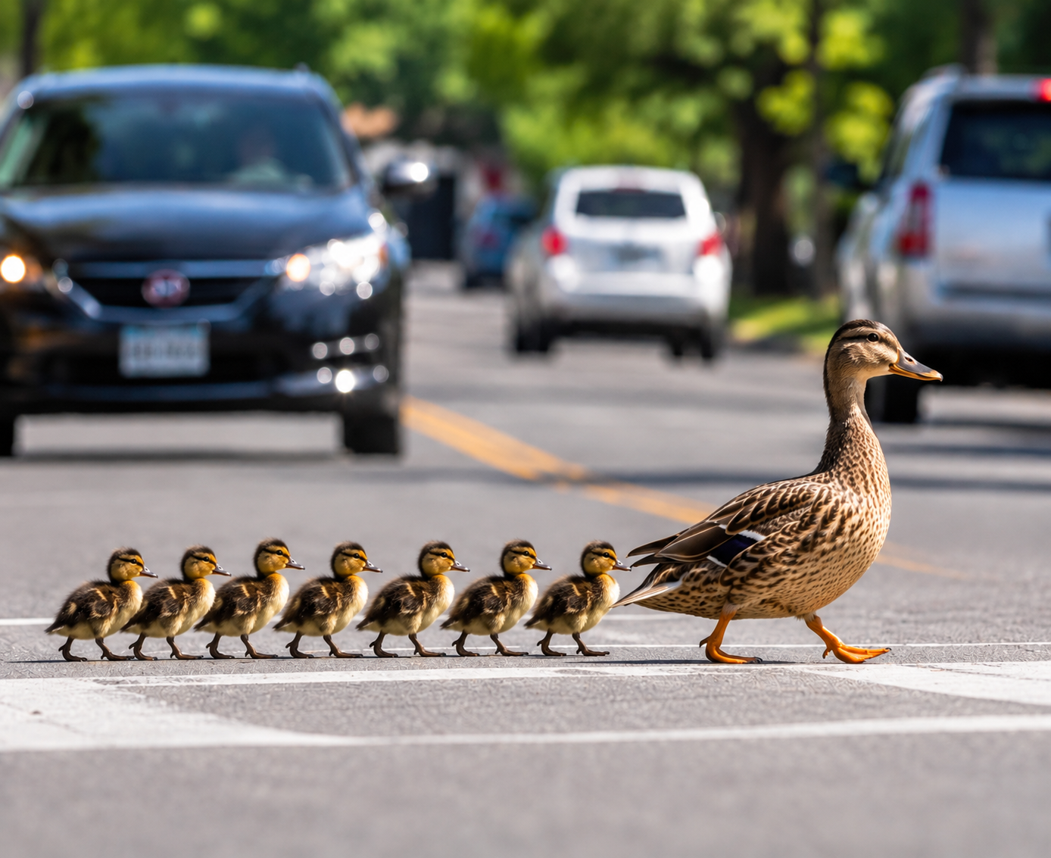
Follow Me
Second Series

Slide 2
FOLLOW ME #4
Opening Prayer
• Lord Jesus, show us where we have made following You too comfortable.
• Help us hear Your invitation without softening Your words.
• Expose what we are still keeping off-limits.
• Give us courage to surrender what You ask for.
• Remind us that grace came first — and You are worth following.
Notes:
Pray this or use it as prompts.

Slide 3
FOLLOW ME
The Series Anchor
“Follow Me, and I will make you become fishers of men.” — Mark 1:17
FOLLOW ME
I WILL MAKE YOU
FISHERS OF PEOPLE
relationship
+
Obedience
(Lordship)
Jesus
transforms
us
help others
follow
→
→
Notes:
Repeat the series anchor every week. Today’s message sits under “Follow Me”: Jesus has first claim on the whole life.

Slide 4
OUR SIMPLE RHYTHM
Hear It → Obey It → Pass It On → Check In
Truth should move from the sermon into life — and from us into someone else.
HEAR IT
OBEY IT
PASS IT ON
CHECK IN
What did
Jesus say?
What will
I do?
Who could
benefit?
Who will help me
follow through?
→
→
→
Notes:
This is the repeating mechanism: hear, obey, pass on, check in.

Slide 5


THE STORY SO FAR – Building our house
1 Corinthians 6:19–20 - building your temple to glorify God.
#1 FOLLOW ME
1. CHRIST — CRUCIFIED • RISEN • LORD
BUILD A LIFE THAT FOLLOWS JESUS
Notes:
Opening build sequence. Advance through these slides like an animation. #1 is the series call: Follow Me → I will make you → fishers of people. Christ crucified, risen and Lord is the bedrock beneath the whole journey.

Slide 6

FOLLOW ME → I WILL MAKE YOU → FISHERS OF PEOPLE
THE STORY SO FAR
#1 FOLLOW ME
#2 LOVE PROTECTS
SAFE
27 October 2026
1. CHRIST — CRUCIFIED • RISEN • LORD
BUILD A LIFE THAT FOLLOWS JESUS
Notes:
Reveal #2 as a shield beside the house: Love protects the vulnerable — and uses the right process. Do not force Safe Spaces into the building structure; it remains a protection marker.

Slide 7

FOLLOW ME → I WILL MAKE YOU → FISHERS OF PEOPLE
THE STORY SO FAR
#1 FOLLOW ME
#2 LOVE PROTECTS
#3 HEAR + OBEY
SAFE
2.
27 October 2026
3. HEAR + OBEY
1. CHRIST — CRUCIFIED • RISEN • LORD
BUILD A LIFE THAT FOLLOWS JESUS
Notes:
Reveal #3 as the foundation layer: Hear + Obey. Review: a disciple does not merely hear Jesus; a disciple does it. Build on the rock by hearing and doing His words.

Slide 8
No Greater Joy
I have no Greater Joy than
to hear that my children
are walking with the truth.
3 John 1:4.

Slide 9
LOOK BACK (Chocolate Opportunity)
Hear & Obey — Did We Build?
OBEY IT
PASS IT ON
CHECK IN
What was ONE clear thing Jesus made clear?
Did you actually do it?
Who did you tell
what you learned?
Who benefited because you passed it on?
Did your scuba buddy ask?
What happened?
What did you learn?
Celebrate movement. Learn from delay. Keep following.
Notes:
Do not skip accountability. Ask for brief shout-outs. Keep it safe: celebrate attempts, not just perfect outcomes.

Slide 10
FOLLOW ME → I WILL MAKE YOU → FISHERS OF PEOPLE
THE STORY SO FAR
#1 FOLLOW ME
SURRENDER — NOT CONVENIENCE
#2 LOVE PROTECTS
#3 HEAR + OBEY
SAFE
TODAY
#4 COUNT THE COST
HEAR + OBEY
CHRIST — CRUCIFIED • RISEN • LORD
BUILD A LIFE THAT FOLLOWS JESUS
Notes:
Reveal today’s new frame: #4 Count the Cost. The frame represents surrender and structure. Following Jesus means surrender, not convenience.

Slide 11
FOLLOW ME — REVIEW
What Have We Learned So Far?
#1 FOLLOW ME
Follow Me → I will make you → fishers of people.
#2 SAFE SPACES
Love protects the vulnerable — and uses the right process. (hugs are for families and No Phones)
#3 HEAR & OBEY
A disciple does not merely hear Jesus. A disciple does it.
Today we add the next piece to the house.
#4 TODAY
Following Jesus means surrender, not convenience.
Notes:
This is the verbal memory slide that follows the visual build sequence. Keep these one-liners locked and repeat them week to week.

Slide 12
FOLLOW ME #4
TAKE UP YOUR CROSS
COUNT THE COST
Luke 9:23–25 • Luke 14:25–33
Following Jesus means surrender, not convenience.
Notes:
Title slide. Let the room sit with the line: Following Jesus means surrender, not convenience.

Slide 13
Luke 9:23–25
23 Then he said to them all, “If anyone wants to become my follower, he must deny himself, take up his cross daily, and follow me. 24 For whoever wants to save his life will lose it, but whoever loses his life because of me will save it. 25 For what does it benefit a person if he gains the whole world but loses or forfeits himself?

Slide 14
Luke 14:25–33
²⁵ Now large crowds were accompanying Jesus, and turning to them he said, ²⁶ “If anyone comes to me and does not hate his own father and mother, and wife and children, and brothers and sisters, and even his own life, he cannot be my disciple. ²⁷ Whoever does not carry his own cross and follow me cannot be my disciple. ²⁸ For which of you, wanting to build a tower, doesn’t sit down first and compute the cost to see if he has enough money to complete it? ²⁹ Otherwise, when he has laid a foundations and is not able to finish the tower, all who see it will begin to make fun of him. ³⁰ They will say, ‘This man began to build and was not able to finish!’ ³¹ Or what king, going out to confront another king in battle, will not sit down first and determine whether he is able with 10,000 to oppose the one coming against him with 20,000? ³² If he cannot succeed, he will send a representative while the other is still a long way off and ask for terms of peace. ³³ In the same way therefore not one of you can be my disciple if he does not renounce all his own possessions.

Slide 15
TODAY’S BIG IDEA
Following Jesus Means Surrender, Not Convenience
JESUS DOES NOT ASK TO BE
AN ADD-ON TO MY LIFE.
HE IS LORD OF IT.
COUNT THE COST — THEN FOLLOW.
Notes:
Main one-liner for today: Following Jesus means surrender, not convenience. Supporting line: Jesus does not ask to be an add-on; He is Lord.

Slide 16
LUKE 9:23
“If anyone would come after me, let him deny himself and take up his cross daily and follow me.”
DENY SELF • TAKE UP YOUR CROSS • FOLLOW JESUS
Notes:
Read slowly. Do not rush past the three verbs.

Slide 17
LUKE 9:23
“If Anyone…”
THIS IS NOT AN ADVANCED CLASS
FOR SUPER-CHRISTIANS.
NOT JUST
JESUS SAID
pastors
missionaries
“serious” Christians
“If anyone…”
The call belongs to every disciple.
Discipleship is the normal Christian life.
Notes:
Push gently against the idea that surrender is for unusually committed Christians.

Slide 18
DENY YOURSELF
Not Self-Hatred — Surrender of Self-Rule
IT DOES NOT MEAN
IT MEANS
“I am worthless.”
“I have no value.”
“I must erase my personality.”
“I am no longer my own final authority.”
Jesus has first claim on my choices.
I STOP INSISTING THAT MY WAY GETS THE FINAL WORD.
Notes:
Clarify deny self: not psychological self-loathing. It is surrendering the right to rule oneself independently of Jesus.

Slide 19
TAKE UP YOUR CROSS
FOR JESUS’ FIRST HEARERS,
A CROSS WAS NOT A BAD DAY.
IT WAS SURRENDER.
Notes:
Do not trivialise “cross” as any inconvenience. In the first-century Roman world, the cross was an execution instrument. Jesus is using deliberately severe language about surrender and allegiance.

Slide 20
ONE SMALL WORD
Daily
“…take up his cross DAILY and follow me.”
MONDAY
TUESDAY
WEDNESDAY
TODAY
Jesus first.
Jesus first.
Jesus first.
Jesus first.
Surrender is not one dramatic moment.
It becomes a way of life.
Notes:
Emphasise the ordinary daily nature of discipleship.

Slide 21
THE CENTRE
“Follow Me”
DISCIPLESHIP IS A PERSON
BEFORE IT IS A PROGRAM.
NOT
BUT
“How much religion
can I fit around
my life?”
“How does my life
revolve around
Jesus?”
Notes:
Keep Jesus Himself at the centre. The cost is not a self-improvement program. It is following a Lord.

Slide 22
LUKE 9:24
“Whoever would save his life will lose it, but whoever loses his life for my sake will save it.”
THE WAY OF JESUS SOUNDS LIKE LOSS — AND LEADS TO LIFE.
Notes:
This is the great paradox. Clutching control can cost us the life Jesus offers. Surrender to Jesus is not destruction; it is life.

Slide 23
LUKE 9:25
What If I Gain Everything?
“What does it profit a man if he gains the whole world
and loses or forfeits himself?”
THE WHOLE
WORLD
YOUR LIFE
WITH JESUS
100+ years
Eternity
You can gain much and still lose what matters most.
Notes:
Ask: What are we protecting when we refuse surrender? Jesus asks us to evaluate value differently.

Slide 24
TAKE NOTE
The Cost Is About Lordship
THE QUESTION IS NOT:
“HOW MUCH CAN JESUS TAKE FROM ME?”
THE QUESTION IS:
“WHO GETS THE FINAL SAY?”
FOLLOWING JESUS MEANS SURRENDER, NOT CONVENIENCE.
Notes:
This is the memorable centre of the message.

Slide 25

What does it mean to make Jesus “my Lord”?

Slide 26

Lordship Circle video 3:44

Slide 27
LUKE 14:25
A Large Crowd Is Following
WHAT WE MIGHT EXPECT
WHAT JESUS DOES
“Great crowd!
Make it easy.
Keep everyone happy.
Lower the barrier.”
He turns around
and tells them
the cost
of following Him.
Jesus refuses to recruit disciples under false pretenses.
Notes:
Set the scene. Jesus is not chasing attendance statistics. He loves the crowd enough to tell the truth.

Slide 28
LUKE 14:26
“Hate” — A Deliberately Shocking Comparison
Jesus is NOT commanding cruelty, neglect or family hatred.
LUKE 14:26
MATTHEW 10:37
Jesus uses severe language to demand supreme allegiance.
“Whoever loves father or mother MORE THAN ME…”
The parallel helps clarify the point.
No relationship outranks Jesus.
Notes:
Important pastoral clarification. Luke’s “hate” is comparative allegiance language. Matthew 10:37 states the comparison explicitly: love father/mother more than Jesus. Do not use this text to excuse neglect or abuse.

Slide 29
SUPREME ALLEGIANCE
Jesus First — Even Among Good Gifts
FAMILY
IDENTITY
PLANS
APPROVAL
Love deeply.
Jesus first.
Receive it.
Jesus defines me.
Plan wisely.
Jesus can redirect.
Value people.
Jesus gets final say.
The issue is not whether these things are good. The issue is whether they are first.
Notes:
The strongest competitors to Jesus are often good gifts we turn into ultimate loyalties.

Slide 30
LUKE 14:27 (What King would…)
JESUS REPEATS THE POINT:
“Whoever does not bear his own cross
and come after me cannot be my disciple.”
FOLLOWING HIM IS NOT CASUAL.
THE CROSS ENDS THE ILLUSION
THAT I AM MY OWN LORD.
Notes:
Connect Luke 9 and Luke 14. Jesus repeats cross-bearing because this is central, not optional.

Slide 31
LUKE 14:28–30
The Unfinished Tower
STARTED…
BUT NOT
FINISHED
JESUS’ QUESTION
“Which of you, desiring to build a tower, does not first sit down and COUNT THE COST…?”
Luke 14:28
Notes:
Let the unfinished tower do the visual work. Jesus is not trying to frighten sincere people away; He refuses shallow commitment built on illusion.

Slide 32
COUNT THE COST
Jesus Does Not Hide the Fine Print
COME TO JESUS
Grace is offered freely.
FOLLOW JESUS
He becomes Lord, not an accessory.
KEEP FOLLOWING
Surrender becomes daily, not occasional.
Grace is not bait-and-switch. Jesus tells us the truth about following Him.
Notes:
Do not confuse counting the cost with earning salvation. It is honest discipleship, not purchase price.

Slide 33
LUKE 14:31–32
The King Who Counts Before Battle
10,000
vs
20,000
Can I win on my own terms?
SURRENDER IS WISER THAN PRETENDING I AM KING.
Notes:
The king illustration is about facing reality. I cannot follow Jesus while still claiming the throne.

Slide 34
LUKE 14:33
“Any one of you who does not renounce all that he has cannot be my disciple.”
EVERYTHING I HAVE COMES UNDER JESUS’ RULE.
Notes:
Renounce does not necessarily mean every Christian owns nothing. It means possessions cease to be autonomous territory. Jesus has the right to direct how we use what we have.

Slide 35
WHAT COMES UNDER JESUS?
Everything
RELATIONSHIPS
TIME
MONEY
Who has first claim?
Who sets priorities?
Who owns it?
BODY
PLANS
REPUTATION
Who defines faithfulness?
Who can redirect?
Whose approval matters most?
Jesus is not one department in my life. He is Lord of the whole house.
Notes:
Avoid turning this into guilt. Use it as a diagnostic: where is Jesus still treated like a visitor rather than Lord?

Slide 36
PERSONAL DIAGNOSTIC
What Am I Still Reserving for Myself?
“Jesus, You can have everything… EXCEPT ________.”
COMFORT
CONTROL
MONEY
RELATIONSHIP
REPUTATION
TIME
HABIT
FUTURE
FEAR
What am I afraid Jesus might ask me to put under His rule?
Notes:
Pause. Let silence do some work. This is the diagnostic moment.

Slide 37
AVOID THE TWO DITCHES
Cheap Grace vs Earn-It Religion
Left DITCH — NO COST
Right DITCH — EARN IT
“Jesus saves me,
So, obedience does not matter.”
Grace becomes permission
to remain unchanged.
“If I sacrifice enough,
God will accept me.”
Discipleship becomes
a payment plan.
Neither is the Gospel.
Notes:
Hold both truths: salvation is by grace, and grace brings us under the lordship of Jesus.

Slide 38
THE MIDDLE OF THE ROAD
Grace Saves. Followers Surrender.
GRACE
FAITH
LORDSHIP
FOLLOWING
Jesus comes for us.
We receive His gift.
We belong to Jesus.
We learn to surrender.
→
→
→
We do not surrender to buy salvation. We surrender because Jesus has saved us and is Lord.
WE REALISE THAT HE KNOWS WHAT IS BEST FOR OUR LIVES AND WE TRUST HIM!
Notes:
This is the grace-order guardrail.

Slide 39
THE GOSPEL FITS THE MESSAGE
JESUS WENT FIRST.
“Not my will, but yours, be done.”
Luke 22:42
He did not ask us to walk a road He refused.
He surrendered to the Father, went to the cross,
and rose victorious.
THE ONE WHO SAYS “TAKE UP YOUR CROSS” FIRST TOOK UP HIS.
Notes:
This is the direct Gospel bridge: Jesus’ surrender is not merely an example; His cross saves us. But He also goes first on the road He calls us to walk.

Slide 40
THE GOSPEL
The Gift Was Free to Us — Costly to Christ
Our sin separates us from God.
Jesus came to seek and save the lost.
Christ died for our sins and was buried.
God raised Him from the dead.
Forgiveness and new life are received by grace through faith.
We do not pay Jesus back. We freely give ourselves because He has given Himself for us.
Notes:
Keep the Gospel explicit and connected. Salvation is received, not earned. Surrender is grateful lordship, not repayment.

Slide 41
THIS WEEK’S QUESTION
WHAT PART OF MY LIFE
AM I STILL KEEPING
OFF-LIMITS TO JESUS?
Not ten things.
Just One honest area.
One next step.
Notes:
Pause here. Give people time to name the area.

Slide 42
MAKE IT CONCRETE
What Might Surrender Look Like?
TIME
MONEY
Make room for what Jesus has already made clear.
Give / stop gripping / act generously.
FORGIVENESS
PLANS
Release the right to keep rehearsing the offence.
Let Jesus redirect a future you had already decided.
REPUTATION
CONTROL
Obey even if someone thinks you are strange.
Ask for help; stop insisting on your preferred outcome.
Your step may be different. The question is: what has Jesus made clear TO YOU?
Notes:
Examples only. Do not turn these into a checklist. The point is concrete surrender.

Slide 43
SCUBA BUDDY
Never Dive Alone
YOUR BUDDY…
THIS WEEK…
checks in — not checks up
watches your back
helps when you get stuck
encourages you to keep moving
prays with you and for you
Tell one person:
“This is the area I am putting under Jesus’ rule. Please ask me what I did about it.”
Two are better than one. — Ecclesiastes 4:9–10
Notes:
Use the established scuba buddy language. Mutual support, not policing.

Slide 44
HOT POTATO
Pass It On
DO NOT LET TRUTH DIE IN YOUR NOTEBOOK.
1
→
2
→
3
→
4
Who could benefit from ONE thing you learned today — and was not here?
2 Timothy 2:2
Notes:
Keep Hot Potato practical. They do not need to repeat the whole sermon — just one useful scrap of truth.

Slide 45
OBEY & REPORT
This Week’s Challenge
NAME IT
DO IT
TELL IT
WHO WILL ASK?
What area
is Jesus asking
me to surrender?
What concrete
action will show
that surrender?
Who could benefit
from this truth?
Name your
scuba buddy.
ONE SURRENDER. ONE ACTION. ONE PERSON. ONE FOLLOW-UP.
Try to take the first practical step within 48 hours.
Notes:
Concrete challenge. 48 hours is a practical prompt, not a new commandment.

Slide 46
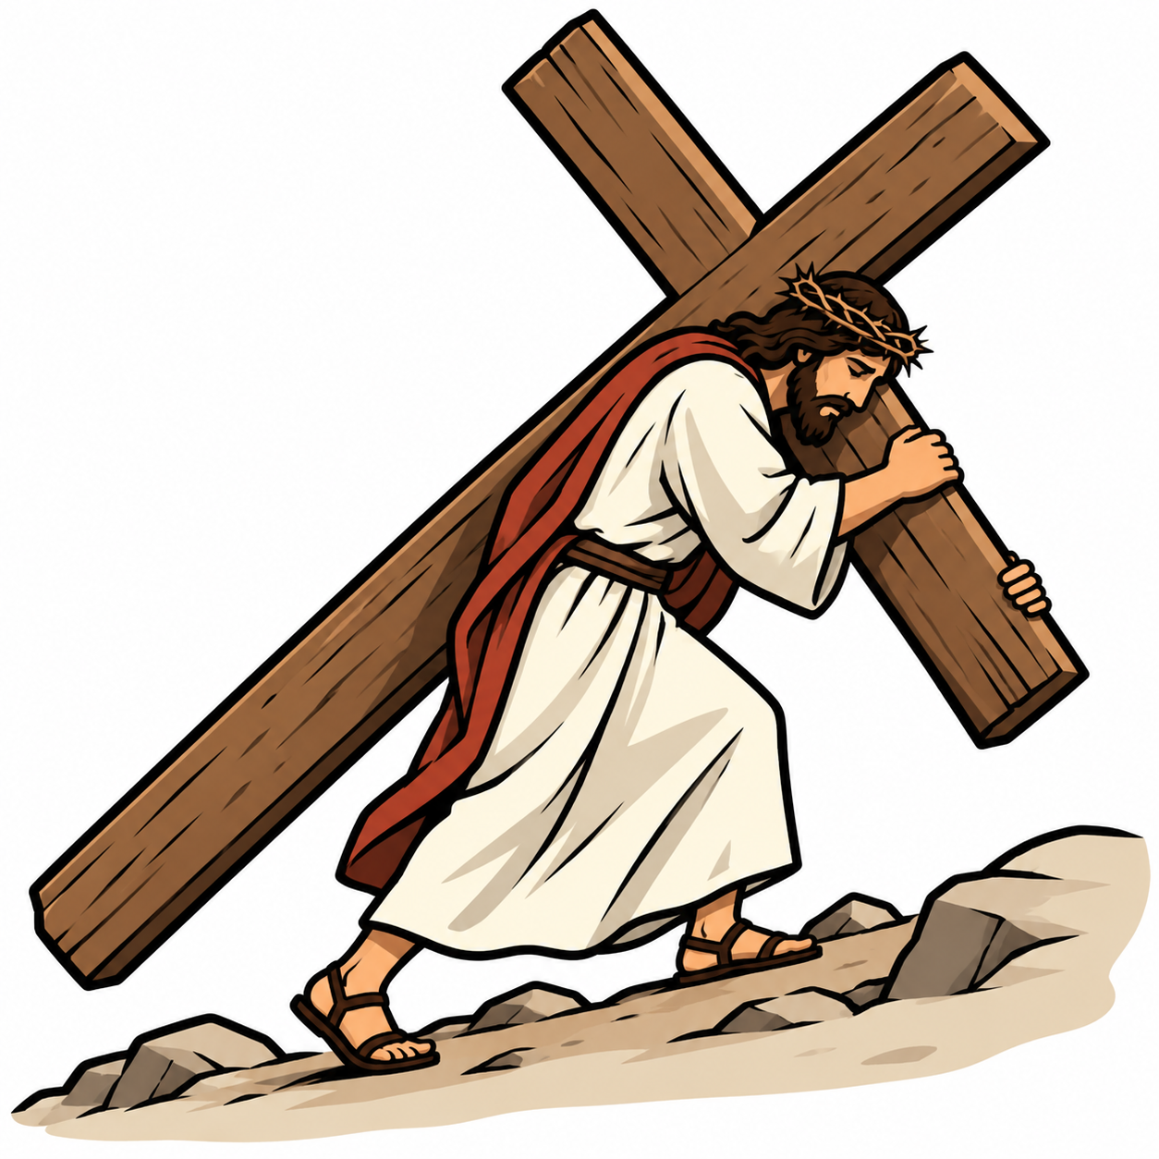
WHAT DO I NEED TO REMEMBER?
FOLLOW ME — The Story So Far
#1 FOLLOW ME
Follow Me → I will make you → fishers of people.
#2 SAFE SPACES
Love protects the vulnerable — and uses the right process.
27 October 2026
#3 HEAR & OBEY
A disciple does not merely hear Jesus. A disciple does it.
#4 COUNT THE COST
Following Jesus means surrender, not convenience.
HEAR IT → OBEY IT → PASS IT ON → CHECK IN
Notes:
Lock the one-liners. Repetition is the memory strategy. Do not keep rewriting them week to week.

Slide 47
Closing Prayer
Thank You, Jesus, that You gave Yourself for us.
Show us what we are still holding back.
Help us surrender every part of our lives to Your rule.
Give us courage to deny ourselves and take up our cross daily.
Teach us to trust You when obedience is costly.
Help us follow You faithfully and help others follow You too.
Protect us and help us this week to do just one thing that we have been holding back from you.
In your name Amen
Closing Prayer
FOLLOW JESUS. SURRENDER DAILY. HELP OTHERS FOLLOW.
Notes:
Closing prayer. End with grace, not pressure.

Slide 48
REFERENCE — HIDDEN
Luke 14:26 — “Hate” and the Matthew Parallel
Luke 14:26 uses deliberately severe comparative language: Jesus demands allegiance above even the closest family ties.
Matthew 10:37 expresses the same priority more explicitly: “Whoever loves father or mother more than me…”
Pastoral guardrail: this text is never permission for cruelty, neglect, abandonment or abuse. The point is supreme allegiance to Jesus. (See 10 commandments)
Notes:
Hidden reference slide for presenter review.

Slide 49
REFERENCE — HIDDEN
Cross-Bearing — Historical Guardrail
In the Roman world, the cross was an instrument of execution, public shame and loss of control.
Do not reduce “take up your cross” to ordinary annoyances such as a difficult day or minor inconvenience.
Jesus’ language is deliberately serious: the disciple relinquishes self-rule and follows Him even when obedience is costly.
Notes:
Hidden reference slide for presenter review.

Slide 50
REFERENCE — HIDDEN
Grace and Cost — Keep the Order Right
Salvation is received by grace through faith; sacrifice does not purchase acceptance with God.
Counting the cost describes honest discipleship after the invitation of grace.
Useful line: “The gift is free to us because it was costly to Christ. We do not pay Jesus back; we belong to Him.”
Notes:
Hidden reference slide for presenter review.

Slide 51
REFERENCE — HIDDEN
Luke 14:25–33 — Flow of the Passage
25 — Large crowds travel with Jesus.
26 — Allegiance to Jesus above family and even self.
27 — Bear the cross and come after Him.
28–30 — Builder counts cost before starting tower.
31–32 — King counts reality before battle.
33 — Renounce all possessions / all we have comes under His rule.
One movement: Jesus exposes shallow crowd-following and calls for whole-life allegiance.
Notes:
Hidden reference slide for presenter review.

