Slide 1
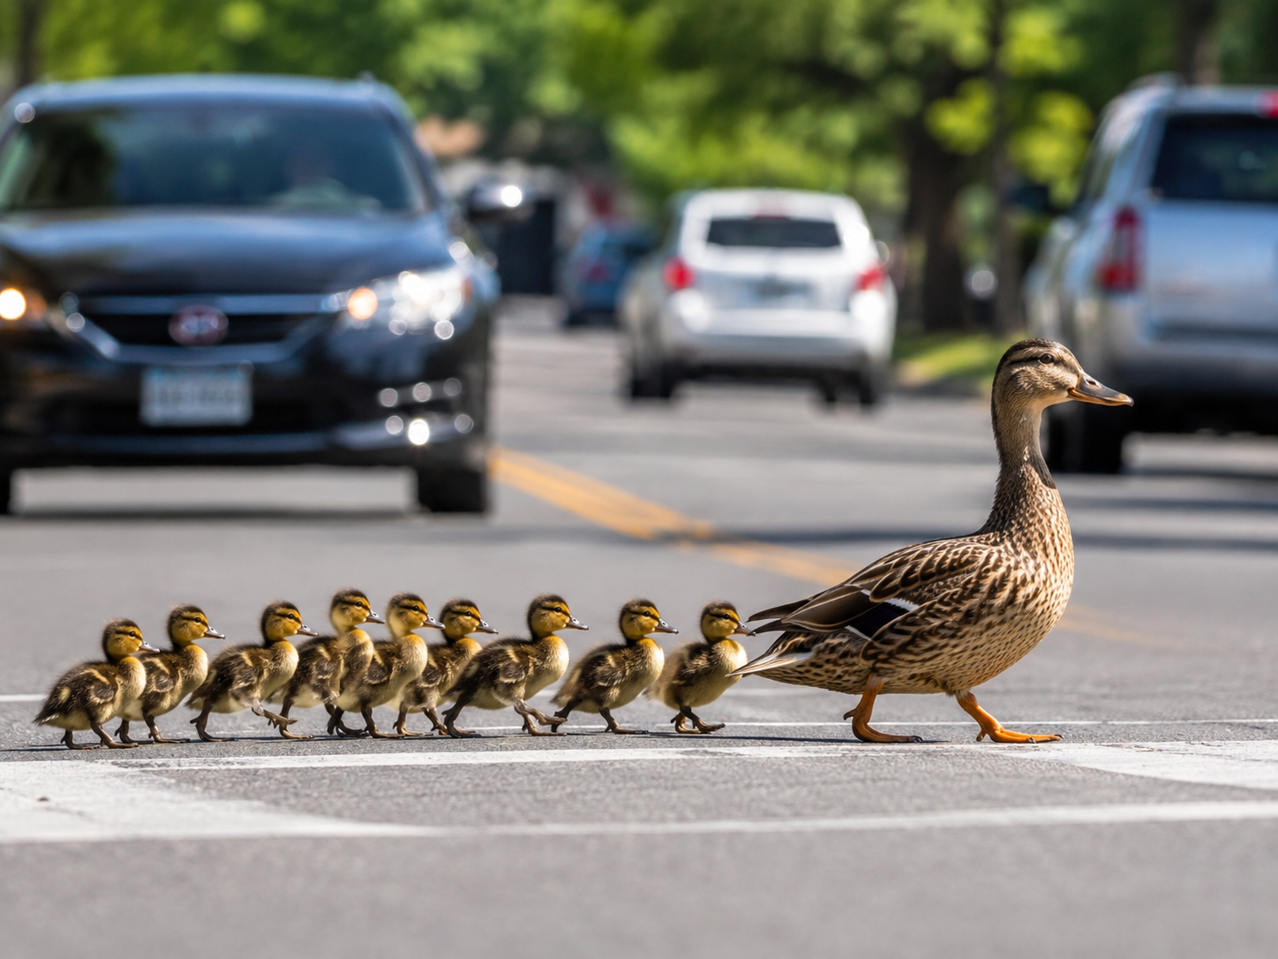
VISION CAST
KEEP JESUS IN VIEW. FOLLOW FAITHFULLY.
HELP THE ONE BEHIND.
Every disciple has a part to play.

Slide 2
VISION CAST
What the Ducks Remind Us
KEEP JESUS IN VIEW
KEEP MOVING
LOOK BACK
Jesus is the leader.
Every disciple follows Him.
Following is active.
A disciple takes the next step.
Who is behind me?
How can I help them keep moving?
We all follow Jesus directly — and we help others follow Him too.

Slide 3
LOOK BACK
No Spectators — Did We Move?
OBEY IT
PASS IT ON
CHECK IN
What was ONE clear step
Jesus asked you to take?
Who did you tell
what you learned?
Did your scuba buddy ask:
How you were going?
Checking in — not checking up. Celebrate movement. Learn from delay. Keep following.

Slide 4
FOLLOW ME
Back on the Planned Journey
LAST SUNDAY
TODAY
LOVE PROTECTS
THE VULNERABLE
HEAR & OBEY
Following Jesus includes doing hard things the right way.
What does a disciple do
with the words of Jesus?
“Hugs are for Families.” &
Report it. Don’t retell it.”
The question remains: What is Jesus asking me to obey?

Slide 5
FOLLOW ME
The Series Anchor
FOLLOW ME
I WILL MAKE YOU
FISHERS OF PEOPLE
relationship
+
obedience
Jesus
transforms
us
help others
follow
“Follow Me, and I will make you become fishers of men.” — Mark 1:17

Slide 6
OUR SIMPLE RHYTHM
Hear It → Obey It → Pass It On → Check In
HEAR IT
OBEY IT
PASS IT ON
CHECK IN
What did
Jesus say?
What will
I do?
Who could
benefit?
Who will help me
follow through?
Truth should move from the sermon into our life,
and from us into someone else.

Slide 7
FOLLOW ME #3
HEAR & OBEY
BUILD ON THE ROCK
A disciple does not merely know what Jesus said;
a disciple does it.
Matthew 7:24–27 • Luke 6:46–49 • James 1:22

Slide 8
FOLLOW ME #3
Opening Prayer
• Lord Jesus, help us hear You — not just another
sermon.
• Show us where we have confused knowing with
following.
• Give us courage to do what You make clear.
• Build our lives on Your words, not our excuses.
• Help us encourage one another to obey.

Slide 9

Zuko’s Super Quick Summary of the Gospels
Mark
What happened
Probably Written first for Romans
fast-moving narrative of Jesus calling and acting
Matthew
What happened
Contains much of Mark
adapted for Jews
Also has more ethical teaching.
History and Genealogy Joesph’s
& his family’s view
Luke
What happened
Contains much of Mark
adapted for All Gentiles
Also has more ethical teaching.
Some different History & Genealogy
from Mary’s point of view
John
Why it happened
Last one written.
It is for both Jews
and Gentiles
Has the most ethical teaching (different)
Tells us about the Nature of God
Fills any holes the first three left out.

Slide 10
TODAY’S BIG IDEA
Discipleship Has Feet
TAKE NOTE
A DISCIPLE DOES NOT MERELY
KNOW WHAT JESUS SAID.
A DISCIPLE DOES IT.
Hearing matters. Understanding matters. But Jesus expects His words to become a life style.

Slide 11
LUKE 6:46
The Uncomfortable Question
“Why do you call me “Lord, Lord,” and not do what I tell you?”
Luke 6:46 Sermon on the Plain
Jesus puts a gap on the table:
OUR WORDS CAN SAY “LORD” WHILE OUR LIVES SAY “NO.”

Slide 12
Matthew’s Sermon on the Mount Vs
Luke’s Sermon on the Plains
We are not sure if Matthew’s recorded sermon is the exact same
sermon on the same day that is recorded in Luke.
Jesus was an itinerant teacher (Rabi). So,
it is more than possible that he delivered the “same”
sermon on different days in different locations.
That would account for the differences between the accounts.
Matthew shows us the breadth of what Jesus has just taught.
While, Luke makes his point painfully explicit.

Slide 13
MATTHEW 5–7
Jesus Has Been Teaching
KINGDOM LIFE
KINGDOM PRACTICES
KINGDOM RELATIONSHIPS
Beatitudes • salt & light
anger • lust • marriage
truthfulness • retaliation
love your enemies
giving • prayer • fasting
forgiveness • treasure
trust / do not worry
judging • ask / seek / knock
Golden Rule • narrow gate
fruit / false prophets
“Lord, Lord” • obedience
Then Jesus closes the sermon with a picture: TWO BUILDERS.

Slide 14
MATTHEW 7:24
The Wise Builder
“Everyone who hears these words of mine and does them will be like a wise man who built his house on the rock.”
Matthew 7:24
HEARS
+
DOES
ROCK

Slide 15
MATTHEW 7:26
The Foolish Builder
“Everyone who hears these words of mine and does not do them will be like a foolish man who built his house on the sand.”
Matthew 7:26
HEARS
+
DOES NOT
SAND

Slide 16
NOTICE THE DIFFERENCE
Both Builders Heard Jesus
WISE
FOOLISH
HEARD JESUS
AND DID IT
HEARD JESUS
AND DID NOT
The difference was not exposure to truth.
It was response to truth.

Slide 17
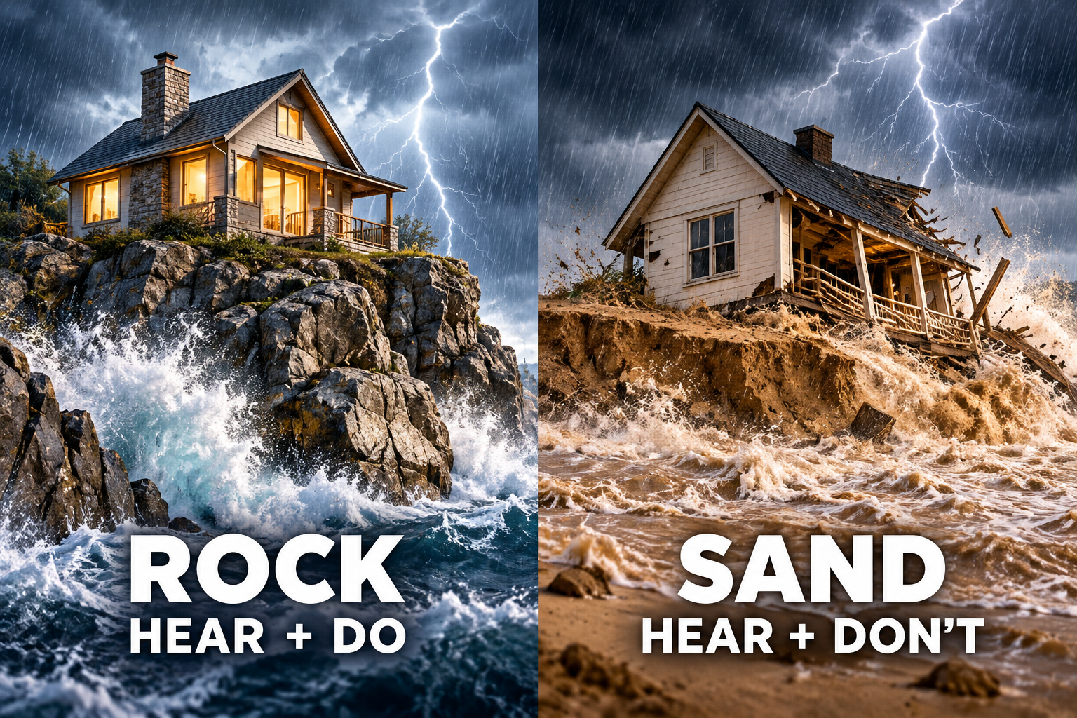
BUILD ON THE ROCK
Same Words. Same Storm. Different Foundation.

Slide 18
MATTHEW 7:25, 27
The Storm Comes to Both Houses
RAIN
FLOODS
WINDS
pressure
from above
pressure
from below
pressure
from every side
Jesus does not promise a storm-free life.
He tells us to build a life that can stand.

Slide 19
BEFORE THE STORM
Foundations Are Built in Ordinary Days
TODAY
NEXT
REPEAT
THEN
hear Jesus
take the step
build a habit
stand when tested
Crisis usually reveals the foundation we have already been laying.

Slide 20
DIAGNOSTIC
The Rock Is Not…
✕ Knowing the right answer
✕ Owning several Bibles
✕ Taking excellent sermon notes
✕ Being at church every week
✕ Agreeing that Jesus is right
✕ Having a Christian background
Good things can still become sand if they never become obedience.

Slide 21
TAKE NOTE
What Is the Rock?
HEARING JESUS
AND DOING WHAT HE SAYS.
Not perfect obedience.
Not instant maturity.
But walking in a set direction:
When Jesus speaks clearly; I move.

Slide 22
A CHURCH DANGER
Information Is Not the Same as Formation
INFORMATION
FORMATION
I tried to obeyed it.
It changed a habit.
It changed a relationship.
It became visible.
I heard it.
I understood it.
I agreed with it.
I wrote it down!
Jesus is not merely filling notebooks. He is forming disciples.

Slide 23
THE OBEDIENCE GAP
Where Truth Often Gets Stuck
I HEARD IT
I INTEND TO
I DID IT
“That was a good sermon.”
“I really should…”
A concrete step
actually happened.
INTENTION IS NOT YET OBEDIENCE.

Slide 24
WHY DO WE DELAY?
Five Common Excuses
LATER
“I’ll do it when life settles down.”
COMFORT
“That will be awkward.”
COST
“I might lose something.”
CONTROL
“I prefer my way.”
FEAR
“What if it goes badly?”
Delay can sound reasonable while quietly becoming disobedience.

Slide 25
JAMES 1:22–25
The Mirror
“Be doers of the word, and not hearers only, who deceive themselves.”
James 1:22
MIRROR + WALK AWAY
MIRROR + RESPOND
Hear only —
look, walk away, forget.
Hear and do —
look intently, continue, act.
Hear only — look, walk away, forget.
• Hear and do — look intently, continue, act.

Slide 26
JOHN 14:15
Obedience Is Relational
“If you love me, you will keep my commandments.”
John 14:15
LOVE
LISTENS
OBEYS
Biblical obedience is not cold rule-keeping. It flows from belonging to Jesus.

Slide 27
KEEP THE ORDER RIGHT
Grace & Obedience
NOT THIS
THIS
OBEY
↓
EARN GOD’S LOVE
↓
GET SAVED
SAVED BY GRACE
↓
BELONG TO JESUS
↓
LEARN TO OBEY
We do not obey to buy salvation. It is the fruit of our new life that we are changing into.

Slide 28
THE GOSPEL
The Good News Came First
• Our sin separates us from God.
• Jesus came to seek and save the lost.
• Christ died for our wrong doing and was buried.
• God raised Him from the dead.
• Forgiveness and new life are received by grace through faith.
The One who says “Follow Me” is the One who first came for us.

Slide 29
JESUS WENT FIRST
Obedience Cost Him Everything
JESUS
US
receive His gift of grace
call Him Lord
learn His ways
walk in obedience
trusted the Father
obeyed through suffering
went to the cross
rose victorious
Obedience is our response to grace — never its purchase price.

Slide 30
A SIMPLE FILTER
Is Jesus Clear?
CLEAR COMMAND
NOT SURE
JUST AN EXCUSE?
Obey.
Take the next step.
Pray.
Study Bible.
Seek wise counsel.
Take next step
Do not use “discernment”
to postpone the obvious.
When Jesus is clear, disciples move.

Slide 31
REFERENCE — HIDDEN
Discernment Guardrails — “Is Jesus Clear?”
IF a CLEAR BIBLICAL COMMAND
Obey it. Do not wait for a special feeling.
If a WISDOM DECISION
Pray, search Scripture, seek wise counsel, then act responsibly.
Pray, Test it against Scripture, character, counsel and what is God doing around me atm.
If a PERSONAL IMPRESSION
If a SAFETY / LEGAL MATTER
Use the proper process. “Prompt obedience” is never permission for recklessness.
This protects the “When Jesus is clear, disciples move” catchphrase from becoming impulsive or manipulative.

Slide 32
Make It Concrete
Questions to pause on:
• What command of Jesus do you already understand but keep postponing?
• Where has “I intend to” become a comfortable substitute for “I did”?
• What ordinary habit are you building now that will matter when a storm comes?
• Who can ask you next week whether you actually followed through?
Aim: move the room from general agreement to one specific act of obedience.

Slide 33
A PRACTICAL HABIT
Do Not Let Clear Obedience Drift
1
NAME IT
Write the clear step in one sentence.
2
START IT
Take the first practical move promptly.
3
REPORT IT
Tell your scuba buddy what happened.
Prompt obedience is a habit —
not a rush into foolishness.

Slide 34
WHAT MIGHT THIS LOOK LIKE?
One Clear Step
FORGIVE
stop rehearsing the offence
GO DIRECT
talk to them — not about them
SERVE
do the low task nobody notices
PRAY
begin the prayer rhythm you keep postponing
GIVE
act generously where Jesus has convicted you
SPEAK
tell someone what Jesus has done for you
Your step may be different. The question is: what has Jesus made clear?

Slide 35
SCUBA BUDDY
Never Dive Alone
YOUR BUDDY…
THIS WEEK…
• checks in
• watches your back
• helps when you get stuck
• encourages you to keep moving
Tell one person:
“This is what I believe Jesus is asking me to do.
Please ask me about it later.”
Checking in — not checking up. Ecclesiastes 4:9–10

Slide 36
HOT POTATO
Pass It On
DO NOT LET TRUTH DIE IN YOUR NOTEBOOK.
1
2
3
4
Who could benefit from ONE thing you learned today — and was not here?
2 Timothy 2:2

Slide 37
OBEY & REPORT
This Week’s Challenge
KNOW
DO
TELL
WHO WILL ASK YOU?
What did Jesus
make clear?
What exact step
will I take?
Who could benefit
from this truth?
Name your
scuba buddy.
ONE ACTION. ONE PERSON. ONE FOLLOW-UP.

Slide 38
WHAT DO I NEED TO REMEMBER?
Take Note — FOLLOW ME #3
• A disciple does not merely know what Jesus said; a disciple does it.
• Both builders heard Jesus. The difference was obedience.
• The storm reveals the foundation we have already been building.
• We are saved by grace — and grace teaches us to follow Jesus.
• When Jesus is clear, disciples move.

Slide 39
FOLLOW ME #3
Closing Prayer
Lord Jesus,
Thank You that You came for us before we ever followed You.
Forgive us for hearing without doing.
Show us the next clear step.
Give us grace and courage to obey.
Build our lives on Your words.
Make us disciples who help others follow You too.
Amen.

Slide 40
How do I know Jesus wants me to do something?
“I think God is leading me to do this,” don’t rely on the feeling alone. Test it from several directions.
Scripture — Does it agree with what God has already revealed? God will not “lead” us to disobey His written Word. If the idea contradicts Scripture, the answer is no.
Character — Does this direction look like the character of Jesus and the fruit of the Spirit? Does it produce love, truth, humility, purity, courage, patience, self-control — or pride, revenge, selfishness, manipulation and chaos?
Counsel — What do mature, trustworthy Christians say? Not people who will simply agree with me, but people who know Scripture and are willing to challenge me. Proverbs 15:22 is useful here: “Plans fail for lack of counsel, but with many advisers they succeed.”
Providence — What is God actually allowing or arranging around me? Are doors opening or closing? Are circumstances confirming or frustrating the direction? But this one needs a warning: an open door does not automatically mean “God said yes,” and a difficult road does not automatically mean “God said no.” Paul sometimes had open doors with opposition, and sometimes the Spirit prevented him from going somewhere. Providence is supporting evidence, not the final authority.

Slide 41
REFERENCE — HIDDEN
Matthew 7:21–27 — The Immediate Context
Before the builders, Jesus warns that saying “Lord, Lord” is not the same as doing the Father’s will (7:21).
Then He gives the two-builder picture (7:24–27). The closing contrast is therefore not “Christian vs atheist” or “Bible reader vs non-reader.” Both hear Jesus. The contrast is hearing-with-obedience versus hearing-without-obedience.
Presenter note: use this if someone reduces the passage to “Jesus is the rock” without noticing Jesus’ own stated emphasis: hearing His words and doing them.

Slide 42
REFERENCE — HIDDEN
Luke 6:46–49 — The Parallel
Luke makes the logic even more direct:
“Why do you call me ‘Lord, Lord,’ and not do what I tell you?” (6:46)
The person who comes to Jesus, hears His words and does them digs deep and lays a foundation on rock. The person who hears and does not do is like a house built on the ground without a foundation.
Teaching angle: Luke gives three movements — COME → HEAR → DO.

Slide 43
REFERENCE — HIDDEN
James 1:22–25 — Hearers and Doers
James warns that hearing without doing can become self-deception.
Mirror picture:
• Hear only — look, walk away, forget.
• Hear and do — look intently, continue, act.
This is useful for explaining why sermon notes, Bible studies and theological understanding are good — but incomplete until truth reaches behaviour.

Slide 44
REFERENCE — HIDDEN
Grace & Obedience — Verse Pool
Ephesians 2:8–10
Saved by grace through faith; created in Christ Jesus for good works.
Titus 2:11–14
Grace saves and trains us to renounce ungodliness and live godly lives.
John 14:15, 21
Love for Jesus and keeping His commands belong together.
1 John 2:3–6
Knowing Christ becomes visible in keeping His commands and walking as He walked.
Guardrail: obedience is evidence and fruit of grace, not a wage that purchases grace.

Slide 45
REFERENCE — HIDDEN
Word Study — “Do”
Matthew 7 repeatedly uses the ordinary Greek verb ποιέω (poieō) — “to do / make / practise.”
The force is intentionally uncomplicated:
Jesus is not contrasting advanced knowledge with beginner knowledge.
He is contrasting hearing + doing with hearing + not doing.
Presenter note: do not make the Greek carry more weight than the passage itself. The point is plain enough in English.

Slide 46
Matthew’s Sermon on the Mount Compared to
Luke’s Sermon on the Plain in more detail
Matthew is broader and more detailed
while Luke’s is shorter but more focused.

Slide 47
MATTHEW 5–7
These Words of Mine — 1/4
THE BEATITUDES — Matthew 5:3–12 — Kingdom people: humble, merciful, pure, peacemaking, faithful under persecution.
SALT & LIGHT — 5:13–16 — Let your changed life become visible.
JESUS & THE SCRIPTURES — 5:17–20 — Jesus fulfils the Law; Kingdom righteousness goes deeper than appearances.
ANGER & RECONCILIATION — 5:21–26 — Murder begins in the heart; go and make things right.
LUST & PURITY — 5:27–30 — Adultery begins in the heart; deal seriously with sin.
MARRIAGE & DIVORCE — 5:31–32 — Covenant faithfulness matters.
12

Slide 48
MATTHEW 5–7
These Words of Mine — 2/4
TRUTHFUL SPEECH — 5:33–37 — Let your “Yes” be yes and your “No” be no.
DO NOT RETALIATE — 5:38–42 — Give up personal revenge; respond differently.
LOVE YOUR ENEMIES — 5:43–48 — Love and pray even for those who oppose you.
GIVE WITHOUT SHOWING OFF — 6:1–4 — Do righteousness for God, not applause.
PRAY WITHOUT PERFORMING — 6:5–15 — Pray to the Father; His name, Kingdom, provision, forgiveness and protection.
FORGIVE — 6:14–15 — People who receive mercy must become merciful.
13

Slide 49
MATTHEW 5–7
These Words of Mine — 3/4
FAST WITHOUT SHOWING OFF — 6:16–18 — Seek God rather than admiration.
TREASURE IN HEAVEN — 6:19–21 — Your heart follows what you treasure.
THE HEALTHY EYE — 6:22–23 — What directs your inner life matters.
GOD OR MONEY — 6:24 — You cannot serve two masters.
DO NOT WORRY — 6:25–34 — Trust your Father; seek His Kingdom first.
DO NOT JUDGE HYPOCRITICALLY — 7:1–5 — Deal with the plank in your own eye first.
14

Slide 50
MATTHEW 5–7
These Words of Mine — 4/4
USE DISCERNMENT — 7:6 — Grace does not mean abandoning wisdom.
ASK, SEEK, KNOCK — 7:7–11 — Trust the goodness of your Father.
THE GOLDEN RULE — 7:12 — Treat others as you would want them to treat you.
THE NARROW GATE — 7:13–14 — Jesus’ way is not automatically the popular way.
WATCH FOR FALSE PROPHETS — 7:15–20 — Look at the fruit, not merely the claims.
“LORD, LORD” IS NOT ENOUGH — 7:21–23 — Religious language is not the same thing as doing the Father’s will.
THEN: BUILD ON THE ROCK — 7:24–27 — Hear these words — and do them.
15

Slide 51
Luke's version essentially goes: 1/2
Luke 6 — “These Words of Mine”
BLESSING & WARNING
Blessed are the poor, hungry, grieving, persecuted.
But Luke also gives the striking four woes.
LOVE THAT LOOKS DIFFERENT
Love enemies.
Do good to enemies.
Bless them.
Pray for them.
Do not retaliate.
Give generously.
Treat people as you want to be treated.
Be merciful.

Slide 52
Luke 2/2
RELATIONSHIPS & SELF-EXAMINATION
Do not judge or condemn.
Forgive.
Give.
Don't be a blind guide.
Remove your own plank before correcting another.
WHAT IS INSIDE COMES OUT
Good trees produce good fruit.
Bad trees produce bad fruit.
The mouth reveals what fills the heart.
THEN JESUS DRIVES IT HOME
“Why do you call me ‘Lord, Lord,’ and not do what I tell you?”
And immediately:
Two builders.
One comes to Jesus → hears → does.
One hears → does not do.

Slide 53
Luke 6 | Main teaching | Matthew parallel
6:20–23 | Blessings on the poor, hungry, grieving and persecuted | Matt 5:3–12 — Beatitudes
6:24–26 | Four woes to rich, full, laughing, well-spoken-of people | No equivalent block in Matthew's sermon
6:27–28 | Love enemies; do good; bless; pray for persecutors | Matt 5:43–48
6:29–30 | Turn the other cheek; give freely | Matt 5:38–42
6:31 | Golden Rule | Matt 7:12
6:32–36 | Love beyond reciprocity; lend expecting nothing; be merciful | Matt 5:43–48
6:37–38 | Do not judge/condemn; forgive; give generously | Matt 7:1–5; Matt 6:14–15
6:39–40 | Blind leading blind; disciple/student and teacher | No close block in Matthew 5–7
6:41–42 | Speck and plank | Matt 7:3–5
6:43–45 | Tree known by its fruit; heart produces words/actions | Matt 7:16–20, though Matthew applies fruit specifically to false prophets
6:46 | “Why call me Lord, Lord, and not do what I say?” | Matt 7:21–23
6:47–49 | Two builders / foundation / storm | Matt 7:24–27
Luke’s
Sermon on the Plain

